Slide 1
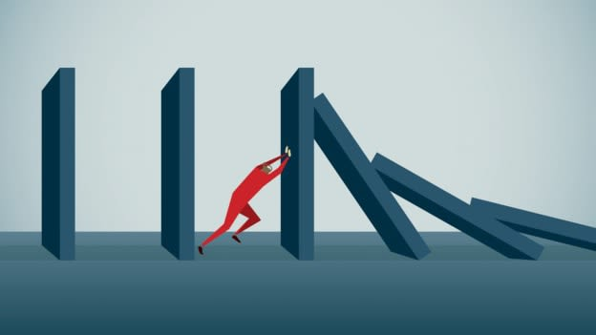
Resilience and Dealing with Uncertainty
CIF Safety Week - 19th October 2020

Slide 2
Pauline Bergin
Accredited Psychotherapist & Supervisor.
Ten years at Pieta House – Centre for prevention of Self Harm & Suicide.
Teacher of Mindfulness.
Private Practice in Dublin.
On Site at Google Dublin – Psychotherapist.
Member of IAHIP – Irish Association Humanistic & Accredited Psychotherapists.
Extensive experience presenting to various groups on the subject of Suicide, Self-Harm, Depression and Anxiety, Mindfulness and Mediation. Trained Army and Police Force around Intervention techniques.

Slide 3
We are trying to live through very difficult times right now and our resilience is challenged.
As people, families, workers, communities. i.e Single people.
Today I want to explore with you the idea of your own resilience.
How to build this
How it will help us live with the uncertainty of the future.

Slide 4
Check time of presentation
Questions format
AOB

Slide 5
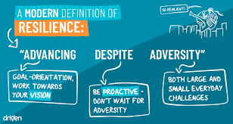
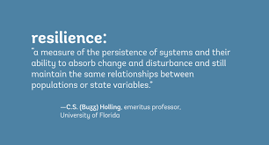
So what is Resilience?
Resilience The ability of a substance to return to its usual shape after being bent, stretched, or pressed (Cambridge English Dictionary)
Psychologists define resilience as the process of adapting well in the face of adversity, trauma, tragedy, threats, or significant sources of stress—such as family and relationship problems, serious health problems, or workplace and financial stressors.
The good news is that we can develop resilience –
It is not something you are born with.

Slide 6
Uncertainty exists in all of us. It’s a human condition as we are not Robots.
We don’t now what's coming our way and we as humans very much like to be in control – know what's around the corner, what to expect.
Preparation to handle
As we all know, todays climate asks of us to “manage the unknown”.
We have to date, not lived our lives in this fashion.

Slide 7
But we can not see around corner
Predict what comes next
Tell the future
But we DON’T know what's coming next
Its usually guess work
If I had that gift of knowing what's coming. – Does that mean it would give us control

Slide 8
Control vs Influence
Control – Outcome = little or no ability to effect the end result.
Influence – Awareness – Ability to MANAGE end result.
Most of the time when we talk about being in control of something, what we are really talking about is influence.
i.e. Influence over weight control
i.e. Relationships
I.e. Health

Slide 9
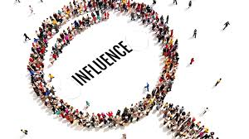
So how do we cope or manage uncertainty if it is something that we are going to continue to experience throughout our lives?
The truth is we are managing uncertainty all the time and we don’t even realise it • We are all coping, maybe not in the way we might want to or in the best way possible, but we are coping The best way

Slide 10
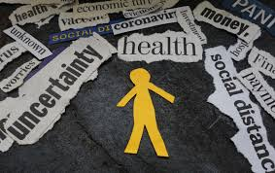
The best way to deal with uncertainty is to build both our actual resilience and our belief or confidence in our own resilience.
Awareness of our abilities

Slide 11
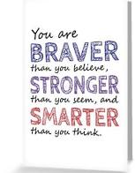
So how do you build resilience?
We build our resilience by overcoming adversity – we learn from experience and build our capacity to cope
• It is hard to build resilience if we have never faced difficult times - LIFE
• The truth is that we are more resilient than we realise – and can become even more resilient if we work at it
Riding a bike – Driving a car – A New Skill

Slide 12
Compassion.
Compassion literally means “to suffer together.”
It is defined as the feeling that arises when you are confronted with another's suffering and feel motivated to relieve that suffering.
Key component in change.
So offering a level of Compassion to self. We can achieve our goals faster.

Slide 13
10 Tips for Building Resilience
(Research by American Psychological Association)
Make connections. Good relationships with close family members, friends, or others are important.
Avoid seeing crises as insurmountable problems. You can't change the fact that highly stressful events – stress us out.
Accept that change is a part of living. Certain goals may no longer be attainable.
Move toward your goals. Develop some realistic goals. Do something regularly
Take decisive actions. Act on adverse situations as much as you can.
Look for opportunities for self-discovery. People often learn something about themselves

Slide 14
10 Tips for Building Resilience
(Research by American Psychological Association)
Nurture a positive view of yourself. Developing confidence in your ability to solve problems and trusting
Keep things in perspective. Even when facing very painful events, try to consider the stressful situation.
Step Back !!!
Maintain a hopeful outlook. An optimistic outlook enables you to expect that good things will happen
Taking care of yourself helps to keep your mind and body
Additional ways of strengthening resilience may be helpful. Slowing down. Big Picture.

Slide 15
Your current safe boundaries
Were once unknown frontiers
Being aware of our own resilience and having confidence in it helps us to manage uncertainty

Slide 17
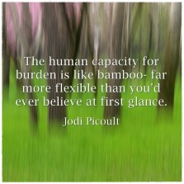
When I look back on all those worries, I remember the story of the old man who said on his deathbed that he had a lot of trouble in his life, most of which had never happened Winston Churchill.
This Photo by Unknown Author is licensed under CC BY-ND
“When you change the way you look at things
The things you look at change” Wayne Dyer
Worry is like a rocking chair, it gives you something to do but never gets you anywhere – Erma Bombeck.

Slide 18
The BEST 6 Doctors
Sunshine
Water
Rest
Air
Exercise
Healthy Eating
Pauline Bergin m.i.a.h.i.p.

Slide 19
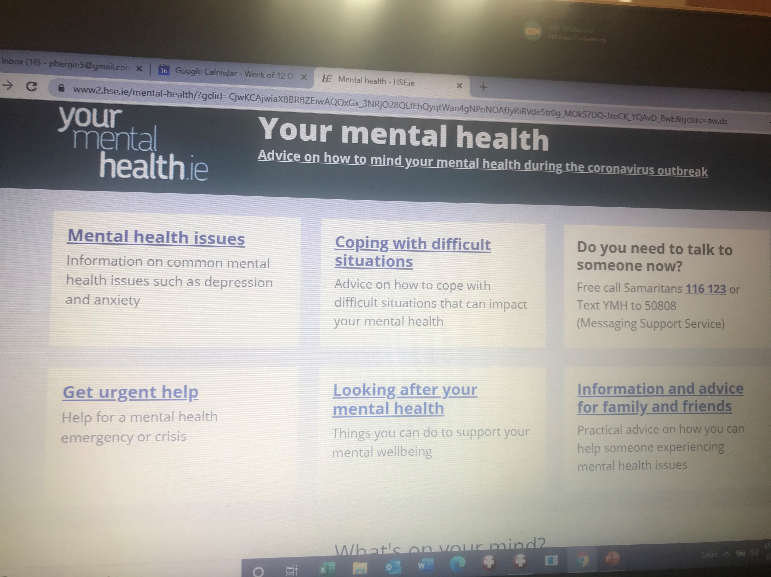
* The Samaritans 116 123
* Your GP/Mental Health Team
* Pieta House 1800 247 247
* The Emergency Department of your local hospital
* Emergency Services 999 or 112.
* www.yourmentalhealth.ie

Slide 20
End of Presentation.
Thank you for your attention.

