Slide 1
Code of Practice for Access & Working Scaffolds
March 2019

Slide 2
Overview
1) Introductions
2) Purpose of the Code of Practice
3) Explanation of Changes to Code of Practice
4) Implementation of the Code of Practice
5) Opportunity for Questions

Slide 3
Purpose
The aim of this Code of Practice is to provide practical guidance to scaffold erectors, contractors and users of scaffolding on the requirements and prohibitions set out in the relevant statutory provisions.

Slide 4
Changes to the Code of Practice
This Code of Practice came into effect on 1st January 2019, replacing the Code of Practice for Access and Working Scaffolds issued by the Health and Safety Authority in 2009.
This followed public consultation, including the Construction Safety Partnership Advisory Committee (CSPAC), the CIF, the National Association of Scaffolding and Access Contractors (NASAC) and the Irish Congress of Trade Unions.

Slide 5
Key Changes to COP (from 2008 version)
1) All scaffolding requires a design:
This requirement includes allowance for proprietary system scaffolding manufacturer’s designs to be used for standard configurations (and other standard designs, such as TG20), to be used as appropriate).

Slide 6
Standards

Slide 7
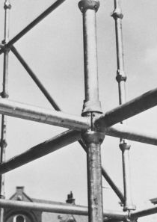
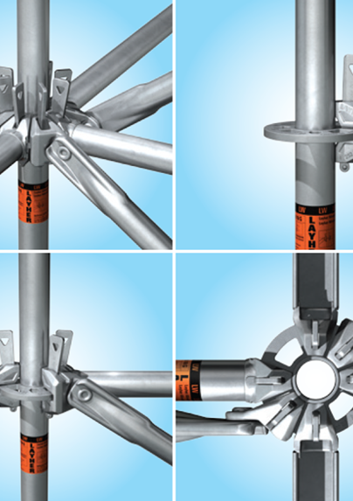
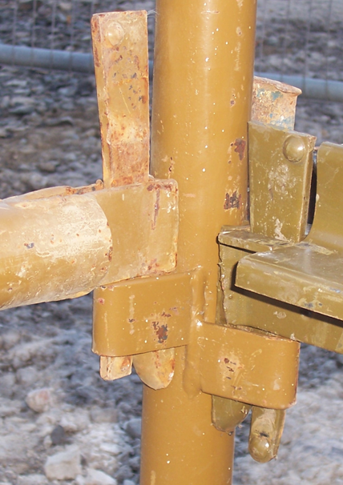
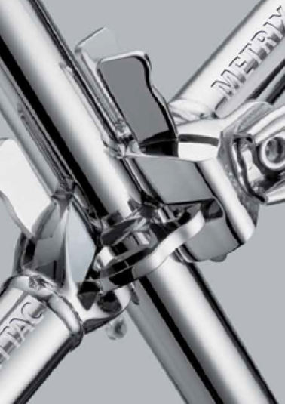
Examples of Scaffolding Manufacturer’s Designs
Cuplok Layher K-Stage System Plettac Metrix

Slide 8
Key Changes to COP (from 2008 version)
2) Consider Scaffold Design & Co-ordinate with Designers:
An increased emphasis on the requirement to identify if a bespoke design scaffold is necessary at the earliest possible stage of a project and for the Project Supervisor Design Process to co-ordinate this temporary works design with the permanent works designer.

Slide 9
Key Changes to COP (from 2008 version)
3) Role of Temporary Works Coordinator
Introduction of the Temporary Works Coordinator to assist the project supervisors in their duties including helping effective communication and co-ordination between the PSDP, designers, the PSCS and the contractors involved in the temporary works/scaffolders.

Slide 10
Key Changes to COP – continued
4) Select Collective Protection Measures
Further requirements for prioritising collective protection measures for scaffolders while erecting, modifying and dismantling scaffolding. The use of leading guard rails and scaffold step systems is introduced and the removal of the previous allowance for scaffolders to work off partially boarded decks.

Slide 11
Key Changes to COP – continued
5) Loading Bays
The removal of allowance for a non-scaffolder to remove handrails under certain circumstances such as when loading materials, and the emphasis on providing appropriate gate systems at loading bays that maintain edge protection to workers during loading operations.

Slide 12
Key Changes to COP (from 2008 version)
6) Precautions when Erecting, Modifying & Dismantling Scaffolding
Further requirements for prioritising collective protection measures for scaffolders while erecting, modifying and dismantling scaffolding.
The use of leading guard rails and scaffold step systems is introduced and the removal of the previous allowance for scaffolders to work off partially boarded decks.

Slide 13
Key Changes to COP (from 2008 version)
7) Provision of Stairway Access
The requirement that stairway access should be provided where it is reasonably practicable to do so, particularly where there is a high usage rate and/or where materials or tools need to be carried frequently by hand.

Slide 14
Key Changes to COP (from 2008 version)
8) Hot Works
The requirement for using flame retardant sheeting material for sheeting scaffold that will have hot works carried out in or near it, or that is erected near the public.

Slide 15
Key Changes to COP (from 2008 version)
9) Protection from High Winds
Requirements to ensure all decking boards are adequately secured and emphasis on the risks of displacement of boards due to high winds.

Slide 16
Key Changes to COP (from 2008 version)
10) Reduction in Maximum Gap
Reduction of maximum gap between scaffold deck and the structure from 300mm to 225mm.

Slide 17
Key Changes to COP (from 2008 version)
11) Storage & Inspection of Scaffold Boards
Requirements for the inspection of decking boards for defects and for the correct storing of timber boards when not in use.

Slide 18
Key Changes to COP (from 2008 version)
12) Training of Persons Inspecting Scaffolding

Slide 19
Key Changes to COP (from 2008 version)
13) Updates from Legislation & Standards
Technical updates with regards to references to current legislation and standards

Slide 20
Key Changes to COP (from 2008 version)
14) Amended GA3 Form
Provision of new template GA3 form for scaffolds incorporating ‘in-use’ checklist

Slide 21
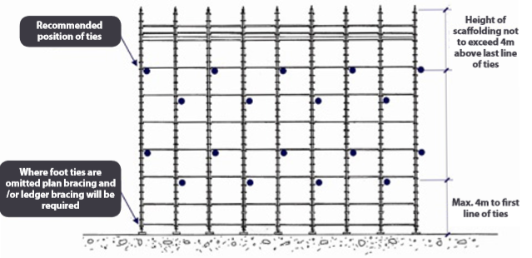
Key Changes to COP (from 2008 version)
15) New Illustrations
Some illustrations were removed and replaced in the latest Code of Practice to reflect recent changes.

Slide 22
Implementation of the Code of Practice

Slide 23
Inspection and Handover

Slide 24
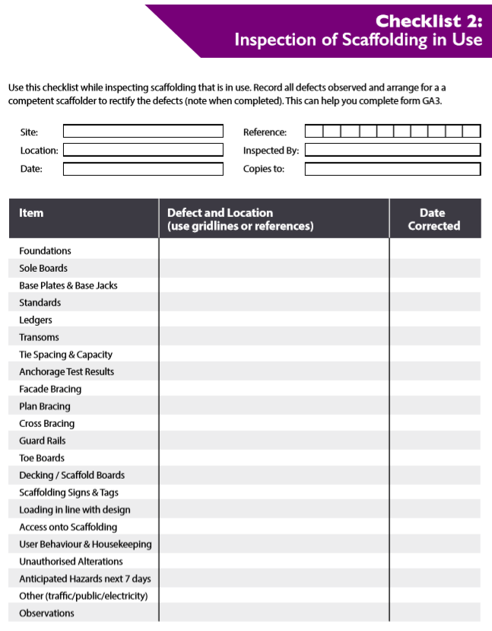
Inspection Checklists

Slide 25
Certificate of Handover

Slide 26
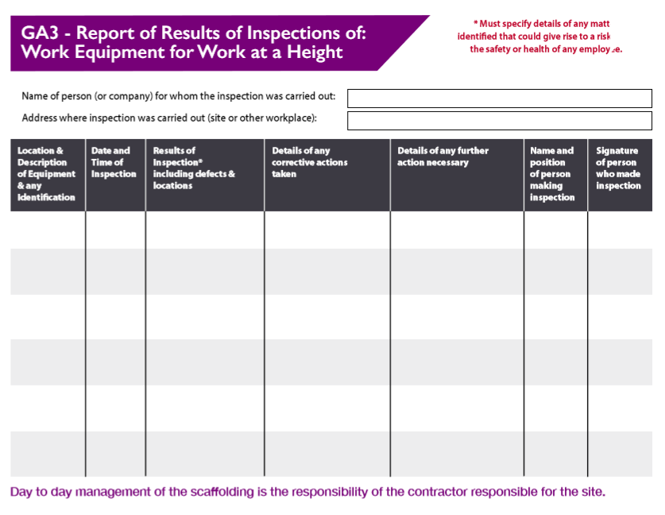
Log Inspections

Slide 27
GA3 Form

Slide 28
Opportunity for Questions
Please type your question into Zoom.
Your question will be treated anonymously and we will endeavour to provide adequate clarifications.

Slide 29
CIF Training Courses - Scaffolding
Two CIF Course Offerings:
Managing & Inspection of Scaffold Training Programme
Code of Practice for Access & Working Scaffolds - Update 2018
Who should attend the CIF’ Scaffold Training Programmes?
This program is an update requirement for those who have already competed the 1-day CIF Management & Inspection of Scaffolding program and priority will be given to these delegates as it will allow their CIF Safety Management card or the New CIF Verification of Competency card to be update.
Those delegates who are attending whom have already completed the 1-day CIF Management & Inspection of Scaffolding program since 2nd December 2008 will be required to attend the half day which will update their current CIF Safety Management Card or the New CIF Verification of Competency Card. Those delegates who have completed the CIF Management & Inspection of Scaffolding program prior to 2nd December 2008 will now need to repeat the one-day course which will be in an update format covering the key changes.
For bookings, click on links provided:
https://ciftraining.ie/product/code-of-practice-for-access-working-scaffolds-update-2018/
https://ciftraining.ie/product/management-and-inspection-of-scaffolding-training-programme/

Slide 30
Thank You!

